Slide 1

Basic Details of the Team and Problem Statement
Ministry/Organization Name/Student Innovation:
AICTE, MIC- Student Innovation
PS Code: 1487
Problem Statement Title: Student Innovation
Team Name: CodeCrafters03
Team Leader Name: Anurag Singh
Institute Code (AISHE): C46229
Institute Name: Galgotia’s College of Engineering and Technology
Theme Name: Clean and Green Technology

Slide 2
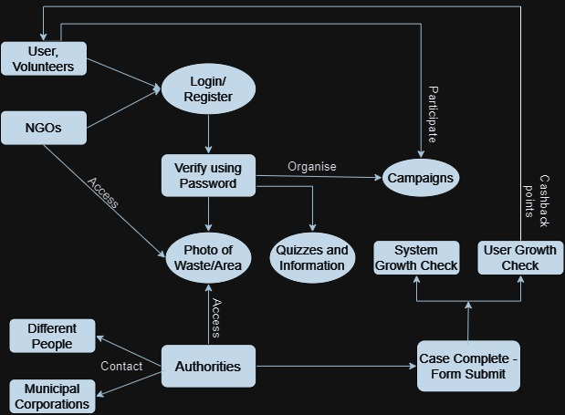










Idea/Approach Details
We are seeking for solutions to Waste Segregation, Disposal & Improvement of Sanitization System through our website. Here users will discover valuable insights & assistance to efficiently manage & dispose of voluminous wastes. Moreover, our platform will dynamically educate individuals, encouraging active participation in these crucial tasks. Here's how our prototype will function:
User Authentication & Registration: Users, NGOs, & unions will undergo a seamless authentication process, utilizing a designated interface to input their credentials securely.
Dynamic Form Generation: After successful validation, authenticated users will gain access to a dynamic form generator with features such as dropdown menus, checkboxes, & other UI elements, enabling the systematic categorization & image upload of wastes to be treated.
Geospatial Data Integration: Upon completing the form, users will be prompted to integrate geospatial coordinates through interactive maps, facilitating precise waste disposal or area cleaning.
Complaint Management Dashboard: NGOs & unions with registered credentials will have access to this dashboard. This dashboard will allow them to filter & categorize complaint forms based on criteria like location, waste types, & quantities. This functionality facilitates collaboration with government bodies & volunteers for effective complaint resolution.
Promotional Strategies and User Engagement: NGOs can employ software-based promotional strategies, including blogs, e-banners, and pop-ups, to engage users and volunteers during various tasks, initiatives, or campaigns. These strategies can also be used to call for user and volunteer participation.
Add process flow chart or simulated image of prototype or any relevant image related to your idea
Technology stack

Slide 3
Idea/Approach Details
Rewarding Accreditation System: Upon task completion, users can submit the final form. A feature known as the Gullak Points System will be in place, where volunteers will be credited with points by uploading pictures of cleaned areas. Approval of these submissions by NGOs or unions will trigger the points allocation process.
Engaging Software Learning with Gamification: Our platform offers interactive software learning modules enriched with gamification elements, fostering proficiency in environment-friendly knowledge. Users earn Gullak Points as a metric of their awareness expertise.
Gullak Points System: Gullak Points are reward points earned through active engagement & expertise. Users can redeem them for certificates, badges, & exclusive partner coupons, recognizing their goodness.
Digital Archive: NGOs, authorities, & experts upload digital assets-posters, journals, blogs-enriching good practices, future campaign plans & activities. Users react, review, & suggest within this knowledge-sharing ecosystem.
Swachh Bharat Mission Portal: Access mission-specific information, schemes & initiatives through our dedicated portal.
Continuous Improvement through User Feedback: User feedback, collected via forms, pop-ups, and chatbots, fuels ongoing platform enhancements, ensuring it meets evolving society needs.
Multilingual Interface: The website will offer a multilingual interface supporting both English and Hindi, with extensibility to accommodate additional languages in future for broader user inclusivity.
User Recognition System: We will employ an advanced user recognition system that does gullak points & other factors based analysis, to identify high-achieving users.
Homepage Showcasing: The homepage will prominently showcase the profiles of these distinguished users, highlighting their names, geographic origins, and profile images to inspire and engage the website's audience.
Dependencies-
Education & participation of people
Technical & Sanitation based awareness among people.
Good infrastructure
Registering web users
NGOs and Authorities

Slide 4
Team Member Details
Team Leader Name: Anurag Singh
Branch (Btech/Mtech/PhD etc): B.Tech Stream (ECE, CSE etc): CSE Year (I,II,III,IV): II
Team Member 1 Name: Ajay Kumar
Branch (Btech/Mtech/PhD etc): B.Tech Stream (ECE, CSE etc): CSE Year (I,II,III,IV): II
Team Member 2 Name: Ansh Pachauri
Branch (Btech/Mtech/PhD etc): B.Tech Stream (ECE, CSE etc): CSE Year (I,II,III,IV): II
Team Member 3 Name: Anushka Mathur
Branch (Btech/Mtech/PhD etc): B.Tech Stream (ECE, CSE etc): CSE Year (I,II,III,IV): II
Team Member 4 Name: Ayush Kumar Dwivedi
Branch (Btech/Mtech/PhD etc): B.Tech Stream (ECE, CSE etc): CSE Year (I,II,III,IV): II
Team Member 5 Name: Devansh Mishra
Branch (Btech/Mtech/PhD etc): B.Tech Stream (ECE, CSE etc): CSE Year (I,II,III,IV): II

